Slide 1
CEN511: EMBEDDED SYSTEMS DESIGN AND PROGRAMMING
COURSE LECTURERS
ODUSAMI MODUPE (Engr.)
OMORUYI OSEMWEGIE

Slide 2
Module 6- Analogue Digital Conversion and Digital Analogue Conversion in Microcontrollers
ADC- Arduino, PIC
DAC- Arduino, PIC

Slide 3
Introduction
Most transducers produce output signals that are an analog of the quantity they represent. Example, the voltage output from a temperature sensor represents the temperature as faithfully as it can, increasing or decreasing as the temperature does the same.
Similarly, a microphone output signal represents the precise characteristics of the sound wave as best it can, in amplitude, frequency and waveform.

Slide 4
Properties of Analogue and Digital Quantities
Properties | Analogue | Digital
Means of (electrical) representation | A continuously variable voltage, or current, represents the variable. | Variable is represented by a binary number.
Precision of representation | Can take infinite range of values; absolute precision is theoretically possible. | Only a fixed number of digit combinations are available to represent measure
Resistance to signal degradation | Almost inevitably suffers from drift, attenuation, distortion, interference. Cannot completely recover from these. | Digital representation is intrinsically tolerant of most forms of signal degradation.
Processing | Analog signal processing using op amps and other circuits has reached sophisticated levels, but is ultimately limited in flexibility and always suffers from signal degradation. | Powerful computer-based techniques available.
Storage | Genuine analog storage for any length of time is almost impossible. | All major semiconductor memory technologies are digital.

Slide 5
ADC’s in Embedded Systems
Generally, ADC’s serve as part of Embedded systems. One typical function is in Data Acquisition Devices.

Slide 6
How ADC’s work
ADC’s map some analog input signal to an output digital equivalent based of a reference voltage.
This typically means a comparison of the input voltage signal to a series of logarithmically decreasing value of the reference voltage.
Some ADC’s are made up of comparators and a resistor network. A comparator is a digital device that compares the magnitude of two voltage sources. The output to this device is a 1 when the reference voltage is exceeded and 0 when its not.

Slide 7
2-bit ADC

Slide 8
Analogue to Digital Conversion

Slide 9
ADC Resolution
A measure of the fineness of conversion is called the resolution. This is the amount by which the input has to change to go from one output value up to the next. In the diagram, the resolution is the width of one step in the conversion characteristic.
An ADC with n output bits can take 2^{n} possible output values, from 0 up to 2^{n-1} . It therefore has a resolution of Vr/ 2^{n}, where Vr is the input voltage range.

Slide 10
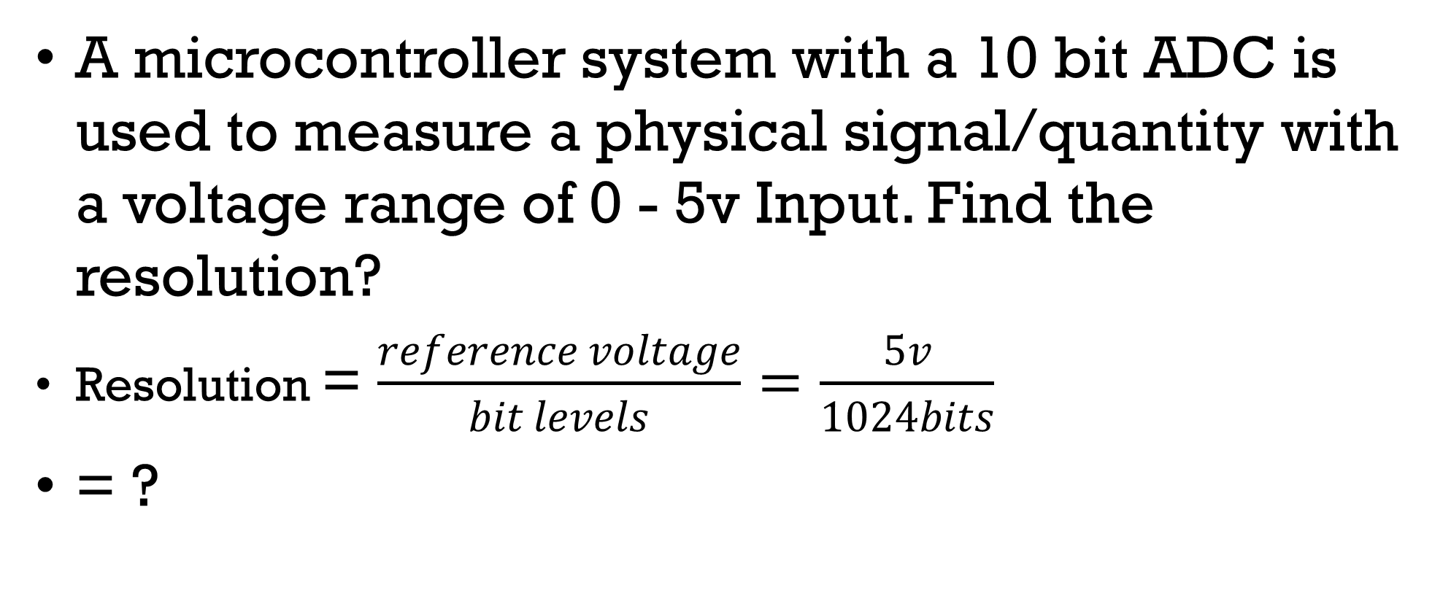
Example
A microcontroller system with a 10 bit ADC is used to measure a physical signal/quantity with a voltage range of 0 - 5v Input. Find the resolution?
Resolution = $\frac{reference voltage}{bit levels}=\frac{5v}{1024bits}$
= ?

Slide 11
Signal conditioning – Amplification and Filtering
To make best use of the ADC, the input voltage should traverse as much of its input range as possible, without exceeding it. Yet most signal sources, say a microphone or thermocouple, produce very small voltages. Therefore, in many cases amplification is needed to exploit the range to best effect. Voltage level shifting may also be required, for example, if the signal source is bipolar while the ADC input is unipolar(voltage is positive only).
If the signal being converted is periodic, then a fundamental requirement of conversion is that the conversion rate must be at least twice the highest signal frequency. This is known as the Nyquist sampling criterion. If this criterion is not met, then a deeply unpleasant form of signal corruption takes place, known as aliasing

Slide 12
DAC
Digital to Analog Converters are electronic devices that convert digital signal into analog. In microcontrollers it is principally achieved via pulse width modulation.
PWM Based Conversion
It is another method used in digital to analog converter & microcontrollers such as Arduino and PICs. This Microcontrollers can be easily programmed to utilize its PWM function to generate an analog output.
Pulse Width Modulation or PWM is a method of varying the average power of a signal by varying its duty cycle. The duty cycle is the % turn on time of the signal, or the % amount of time for which the signal remains high. Like 40% duty cycle signal means it stays high for 40% of time & stays low for 60%.

Slide 13
PWM using filter circuits

Slide 14
PWM using filter circuits
If a PWM stream of fixed Mark : Space ratio is low-pass filtered, with a suitable, cut-off frequency, then the digital stream becomes a DC voltage, with a little residual ripple. If the PWM Mark : Space ratio is modulated, then a varying output voltage can be produced.
We can use a binary number to generate such type signal whose duty cycle depends on the binary digit. The PWM wave is filtered using a low pass filter to remove the fluctuations & provide a smooth analog voltage.
The low pass filter used can be a first order. 2nd order low pass filter would be a great choice for a PWM base digital to analog converter.

Slide 15
Resolution & Step Size of Digital to Analog Converter
Resolution & step size of a DAC plays important role in the precision & accuracy of the analog output.
Resolution is the number of possible output levels a DAC can produce. It depends on the number of input bits.
Resolution = 2^{n}
The resolution of an n-bit DAC is 2^{n}. For example, a 4-bit DAC has resolution of 2⁴ or 16 output levels.

Slide 16
Step Size of a DAC
The step size of a DAC is the smallest change in the analog output & it is the difference between two consecutive output voltage levels.
The step size can be calculated by dividing the range (maximum output voltage) or V_{ref} by 2^{n} where n is the number of bits.
Step size = Range / 2^{n}
For example, the step size of a 4 bit DAC with range of 5v is;
Step size = 5/2⁴ = 5/16 = 0.3125v
The step size of this DAC is 0.3125. So for a single bit increment, its analog output will increase by 0.3125 v.
Increasing the resolution of a DAC decreases the step size & generates a smooth analog wave with much more accuracy.

Slide 17
Applications of DAC
Audio:
The audio signal is analog in nature but it is converted using ADC (analog to digital converter) into digital format to edit & store in storage devices in various digital formats such as mp3, wav etc.
The audio amplifier or the sound card in a system contains DAC that converts the audio signal stored in digital device into an analog signal. The signal can be modified by the amplifier by varying its gain (volume), bass, treble etc. & then converted into analog signal because the speaker cannot support a digital signal.

Slide 18
Applications of DAC
Video:
Digital video players utilize DAC to play any digital video using an analog monitor. These video players convert the digital signal from the digital source file into an analog signal.
A digital video player has digital video ports such as DVI or HDMI. But if it has any analog output ports (composite port of yellow color), it contains a DAC whose job is to convert the video file into analog signal.

Slide 19
Motor Control
One of the most important components in controlling a motor using a digital device such as a microcontroller is a DAC.
In various electronics projects, motor is embedded with a microcontroller. The microcontroller generates a digital signal to vary the speed of the motor which is converted into an analog signal using a DAC (Digital to Analog Converter).

Slide 20
References
Wilmshurst, T. (2006). Designing embedded systems with PIC microcontrollers: principles and applications. Elsevier.

